Slide 1
Read Me: This deck contains two sections. One for participants and a second for coaches.
Participant section
This top section is a Tech Scenario description for participants. The section will cover the technology introduction and high-level concepts about the challenges.
Audience: Participants at OpenHack
Coach only section
This section is a Tech Scenario description for coaches. The section will cover the technology, challenge goals, common pit falls, general guidance on solutions. This section is presented to coaches in the ‘know before you go’ call a few days before the OpenHack starts. This section is intended to be more in-depth than the participant section. Do not share the coach section with participants!
Audience: Coaches at OpenHack
Section 1
Section 2

Slide 2

DevOps OpenHack
Secure Zero Downtime Deployment
#MSOpenHack

Slide 3
Why DevOps OpenHack?
Technologies
GitHub
Azure DevOps
Azure App Service
Log Analytics
Application Insights
Azure Monitor
Azure SQL Database
Azure Container Registry
Key Vault
Bicep
Terraform
Reduced friction in production deployments and ensures deployments of new features can occur more often and safely without requiring system downtime

Slide 4
Event Structure
Focus Areas:
1. Continuous Integration | 2. Continuous Deployment | 3. Security | 4. Monitoring
Difficult problems
Build cool stuff
Fundamentals
Basic functional pipeline with Blue/Green support

Slide 5
Event Goals
Have fun while learning about DevOps through doing
DevOps is about repeatable and predictable velocity through automation
REMEMBER: There are many ways to solve each problem

Slide 6


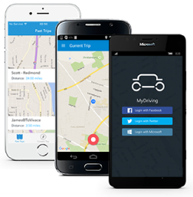

Scenario
You are IT at a fictitious insurance company running the MyDriving Service – a mobile application that collects and send car data to APIs to evaluate a trip.
The company is offering their customers the ability to evaluate their driving skills. Customers connect to a web application that uses the same APIs so any downtime of the APIs would greatly impact business.
Your mission is to update the APIs to incorporate business requirements while keeping the application functional throughout the entire process.
Notes:
Your mission, should you accept it, is to update the APIs to incorporate any business requirements while keeping the application functional.
The success of your team depends on your ability to perform those updates by applying DevOps focused practices to build, test, deploy, and monitor the MyDriving Services. If done properly you will not incur downtime and have visibility of your application throughout the entire process.

Slide 7
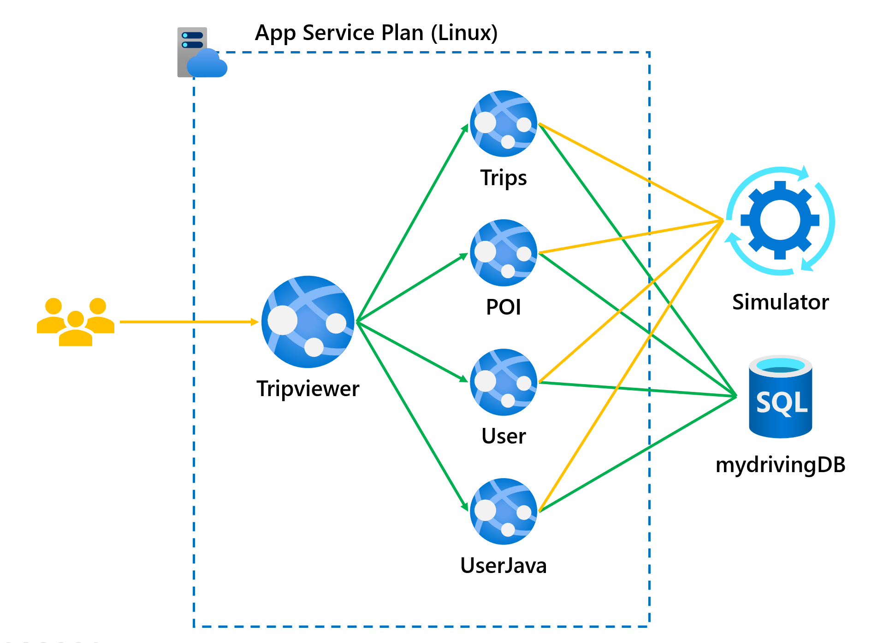
Application & Application APIs
Architecture:
5 Azure Web Apps for Containers each with a staging deployment slot running the following applications:
Tripviewer - the team website that your customers are using to review their driving scores and trips which are being simulated against the APIs.
Trips - the trips API is where the mobile application sends the trip data from the OBD device to be stored.
POI - (Point Of Interests) API is collecting the points of the trip when a hard stop or hard acceleration was detected.
User – the user profile API is used by the application to read the user's information.
User-Java - the user (Java) API is used by the application to create and modify the users.

Slide 8



DevOps is a team sport
People
Process
Technology

Slide 9
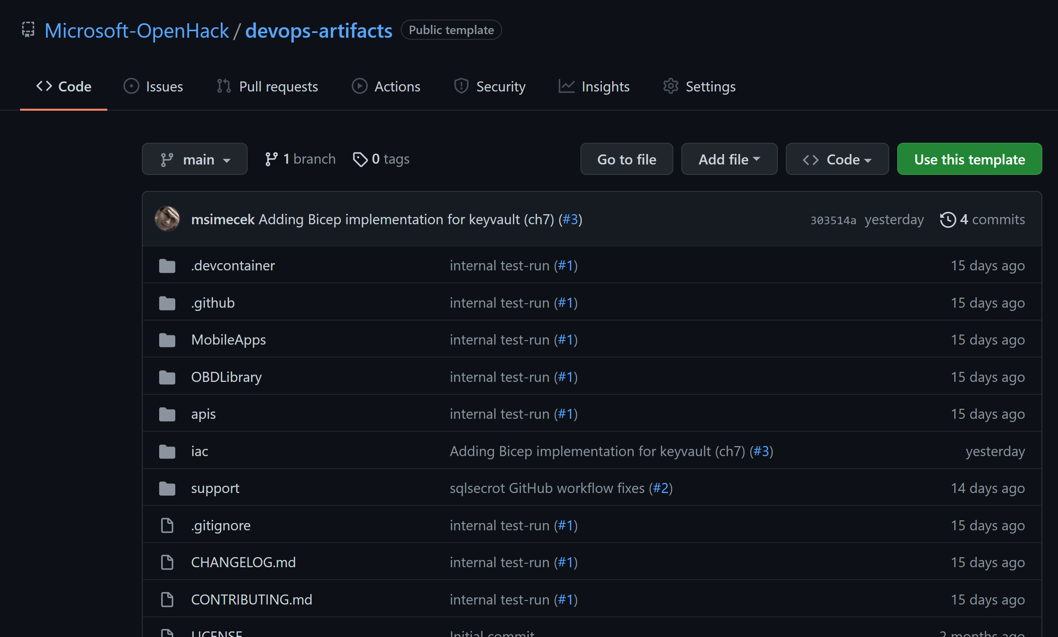
Source code
Micro-services code (APIs)
https://github.com/Microsoft-OpenHack/devops-artifacts

Slide 10
Tools
Azure services and tools
Azure DevOps
Azure App Service
Azure Web Apps for Containers
Azure Key Vault
Azure SQL Database
Azure Container Registry
Open-source services and tools
GitHub
Editor of your choice
VS Code, Sublime, etc.
Azure CLI
GitHub CLI
Notes:
Reinforce Jenkins vs VSTS

Slide 11
Connecting to your environments
Navigate to the OPENHACK ENVIRONMENT tab
The usernames and passwords provided can be used to access your Azure subscription

Slide 12
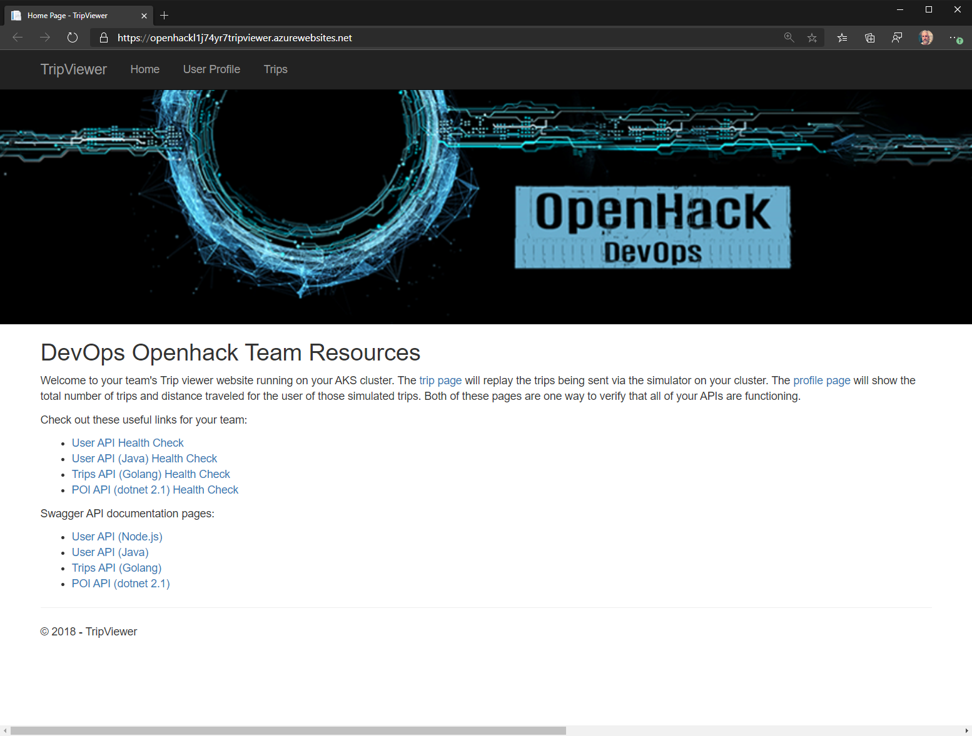
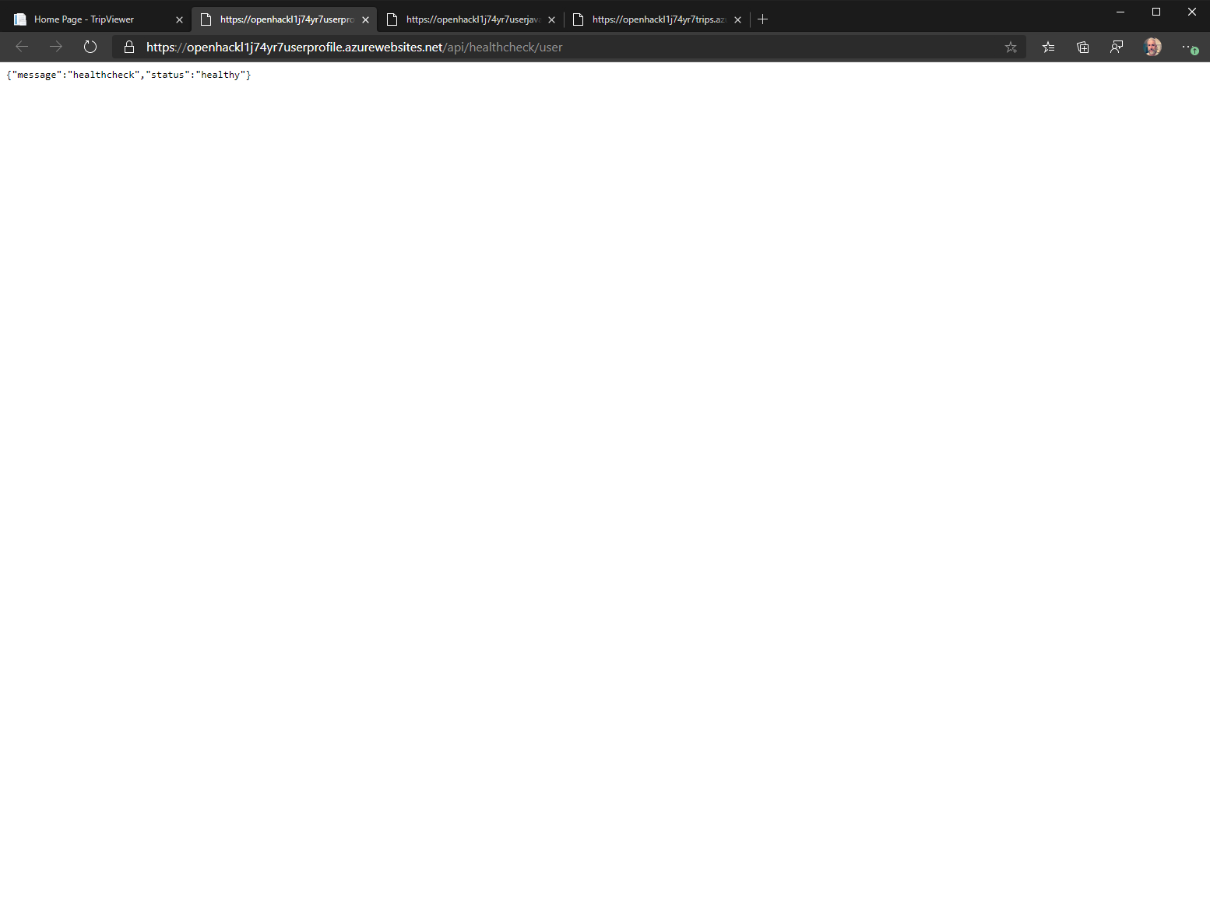

Tripviewer application

Slide 13
Environment Demonstration

Slide 14
Feedback
Goal-Oriented – It states what is trying to be accomplished by the user
Specific – Gives details about the scenario, observations, and/or challenges faced by the user
Actionable – Provide necessary clarifying information to enable a decision

Slide 15

Let’s get started!
https://openhack.skillmeup.com
Login with the credentials supplied to your team.
Notes:
To get started, visit the OpenHack portal:

Slide 16
DevOps
Challenge walkthrough for coaches

Slide 17
Coach solutions folder
https://github.com/Microsoft-OpenHack/devops/tree/main/resources/solutions

Slide 18
Challenge 0
Set the tone / BYOS

Slide 19
Challenge 0 – DevOps Tool Selection and Configuration
While there is no official Challenge 0 in the attendee guide, there are some things you can do to ensure you'll have a successful and productive hack
Have attendees not only read the overview, but also deploy and setup basic configuration of GitHub or Azure DevOps
Follow: https://github.com/microsoft/OpenHack/tree/main/byos/devops
Attendees should be very aware that they are working with a "production" environment before they get hands on keyboard
Encourage attendees – if they can figure out how to do it on the command line, running it in GitHub, Azure DevOps, etc. is much easier once you know the command!

Slide 20
Challenge 0 – DevOps tool selection and configuration
Select the tooling that best fits your team's skills or learning plans
GitHub or Azure DevOps
Deployment steps and scripts are located at https://aka.ms/OpenHackBYOS under devops folder

Slide 21
Challenges flow

Slide 22
Challenges flow
Challenge 5 is a minimum challenge requirement to achieve Badge/TSI credit.
Challenge 5 & 7 have optional additional challenges - it's recommended only for solid teams where all participants want to learn more advanced scenarios.
After Challenge 7, the team can choose the favorite path based on learning needs.

Slide 23
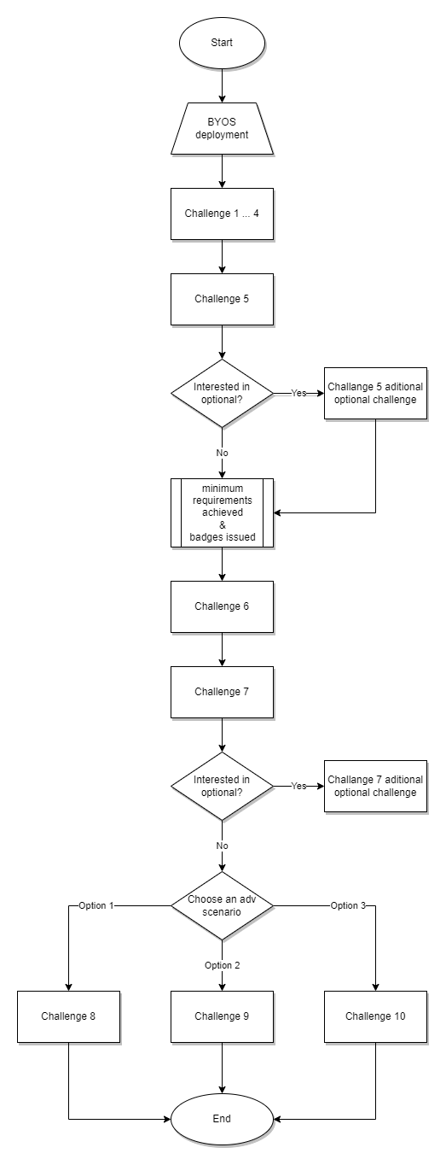
Challenges flow

Slide 24
Challenge 1
Establish your plan

Slide 25
Challenge 2
Setting up development workflow

Slide 26
Challenge 3
Deploy Cloud Infrastructure with Infrastructure as Code (IaC)

Slide 27
Challenge 4
Implement Continuous Integration (CI) with Testing

Slide 28
Challenge 5
Implement Continuous Deployment (CD)

Slide 29
Challenge 6
Implement a Blue/Green deployment strategy

Slide 30
Challenge 7
DevSecOps basics – get rid of secrets

Slide 31
Challenge 8
Integrating quality and security checks

Slide 32
Challenge 9
Implement a monitoring solution with alerting

Slide 33
Challenge 10
Implement phased rollout with rollback

Slide 34
Thank you coaches!

